Slide 1

THE NEED TO REDUCE Childcare CostS
Presented by Jon Jacobson

Slide 2
OUTLINE
How Much Does Childcare Cost
Effects on the Community
Predictive Modeling
Intervention Targets
Recommended Interventions

Slide 3
In most of the United States, childcare costs for just two children exceeds 25% of median family income.

Slide 4
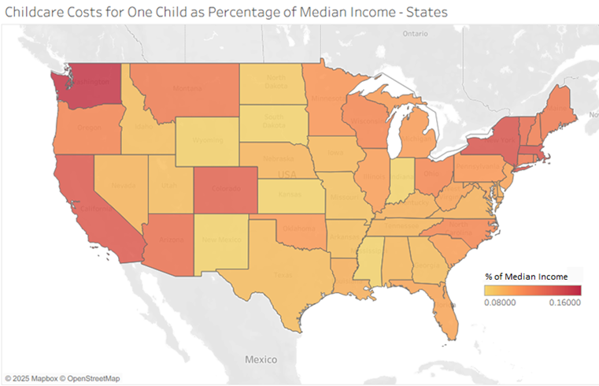
Percentage of Median Family Income
Costs vary widely across the country, so we can't compare directly.
We scale a location's costs by that location's median family income.
This gives us the average cost of childcare as a percentage of an average family's income.
For most of the country, a single child costs more than 12.5% of an average family's income.

Slide 5
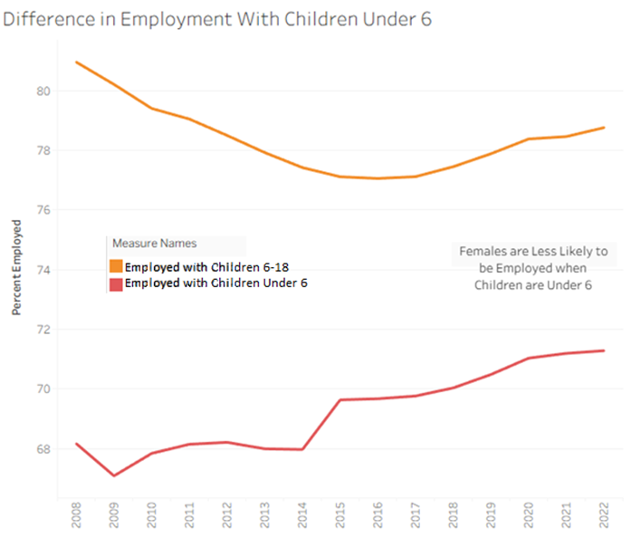
Childcare Costs Reduce FEMALE Employment By a Tenth
Reducing Costs will BENEFIT THE WHOLE COMMUNITY

Slide 6
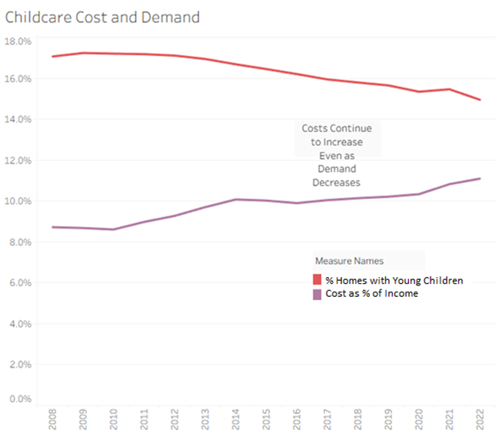
Costs Are Not Responding to Market Factors
Normally, we'd expect supply and demand to be inversely linked, but this is not the case.
Demand has slowly decreased
On average, less homes have young children, but at over 15%, this is still a significant percentage.
Costs have consistently increased
These increases far outpace inflation.
This situation, and the impact it has on our communities, is getting worse.

Slide 7
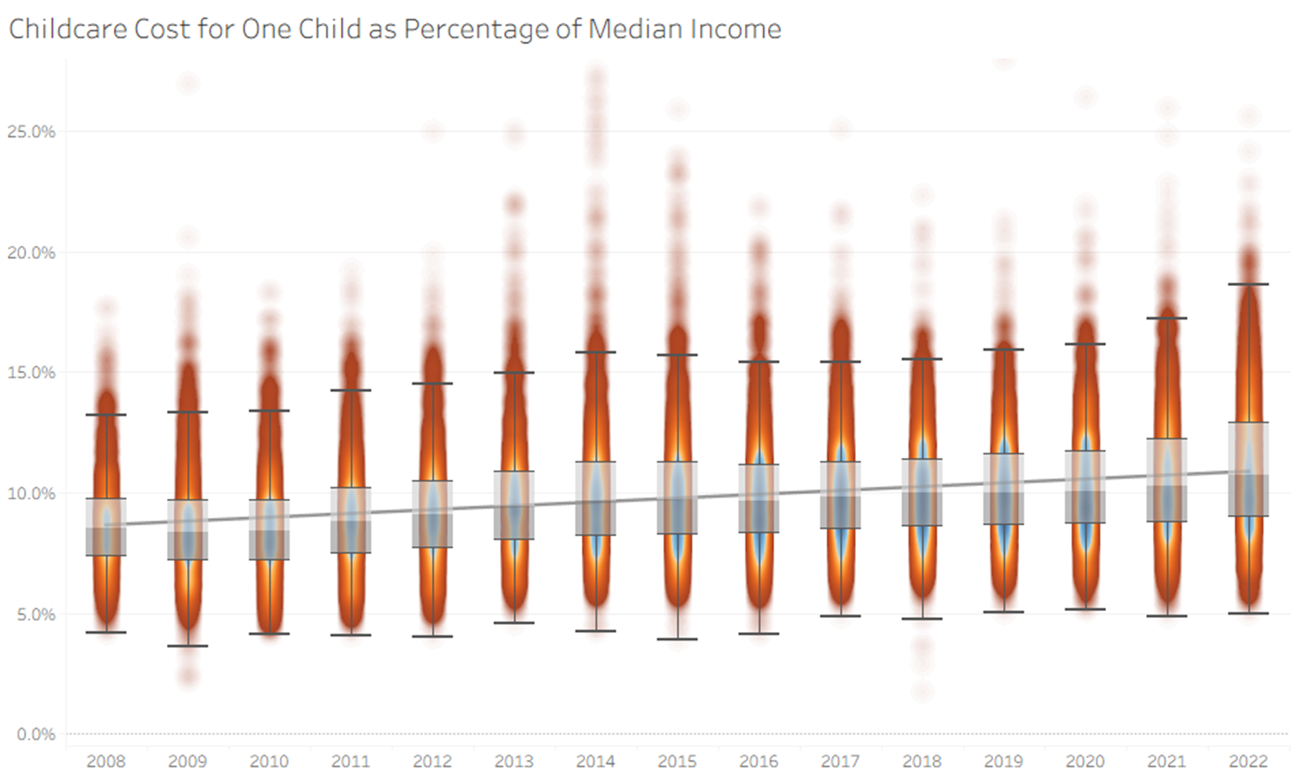
Childcare Costs Outpace Income
Each year's distributions are normal, with little skew on either side.
The variability between years is marginal.
The trend indicates that each year childcare costs consume more of a family's income.

Slide 8
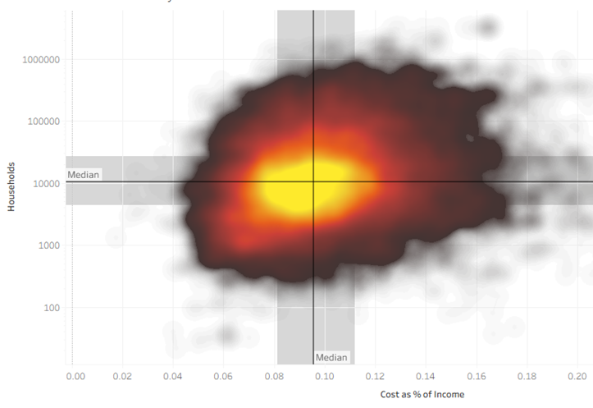
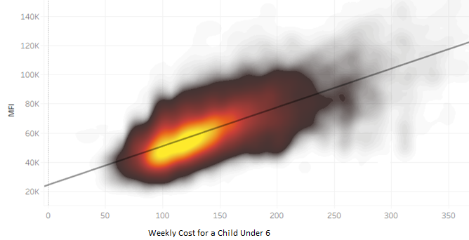
All Variables were Analyzed for Correlation and Predictive Potential
Costs and MFI (Median Family Income) are correlated
Population and costs have little correlation, after accounting for Median Family Income.

Slide 9
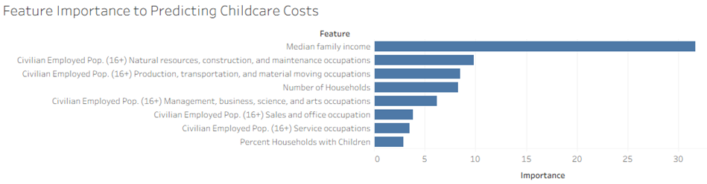
Childcare costs can only be partially predicted by income, job composition, and household statistics.

Slide 10
47%
of THE PREDICTORS for ChildCare Costs are still unknown

Slide 11
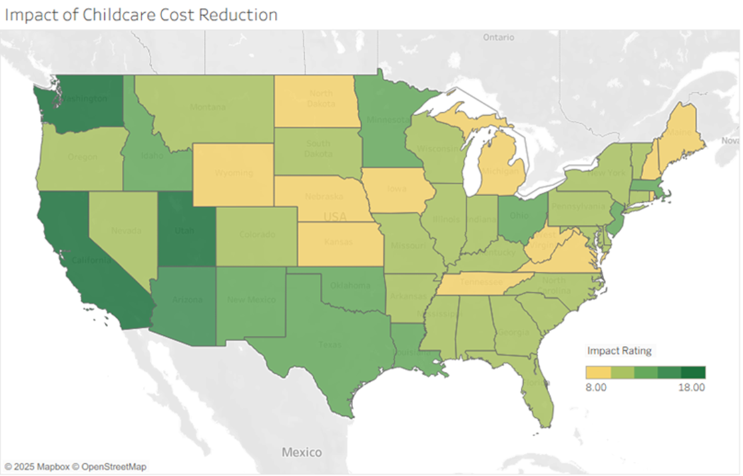
Delivering with confidence
Targets for Intervention
Areas where cost reduction would have the greatest impact is where both factors are high:
Costs as a percentage of median income
Percentage of homes with young children

Slide 12
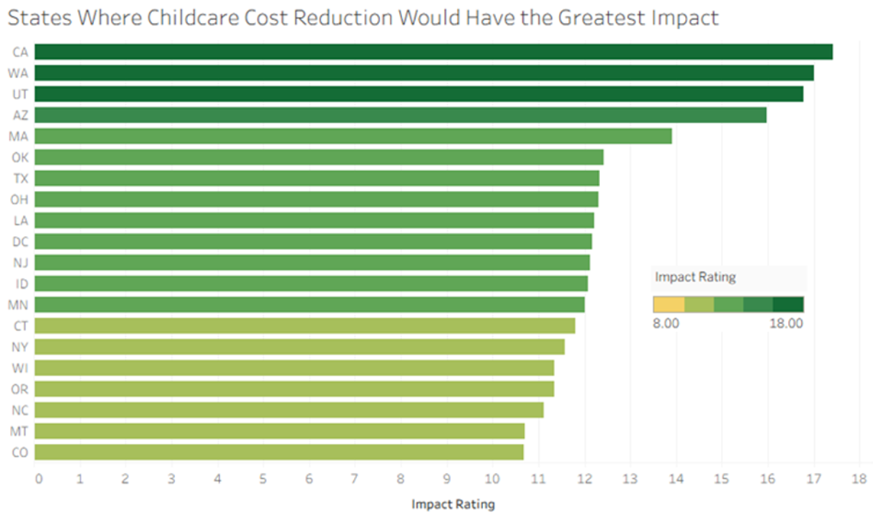
Delivering with confidence
Targets for Intervention
CA, WA, and AZ are high on both maps, but this method calls out UT, MA, and TX where there are more families with young children.

Slide 13
Recommendations
Develop a program to reduce childcare costs soon.
1
Target areas where both costs are high and there is a high proportion of families with young children.
2
Invest in more research so that we can gather additional predictors for this critical issue.
3

Slide 14

Q & A

Slide 15

Data Source
Department of Labor, Women’s Bureau.
National Database of Childcare Prices: 2008-2022 [Data set].
Inter-university Consortium for Political and Social Research.
https://doi.org/10.3886/E226943V1.

